Slide 1
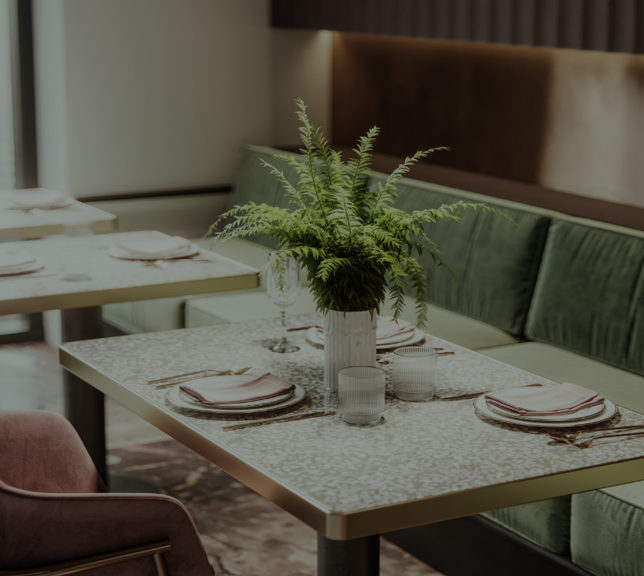
UNT Dining System
h

Slide 2
1
Project Description Brief description of UNT DINING System
ER Diagram Entity Relationship Diagram for UNT DINING System
Tech Stack Tools and Technologies used for the Project
ER Mapping Entity Relationship Mapping
Home Page UNT DINING System
2
3
4
5

Slide 3
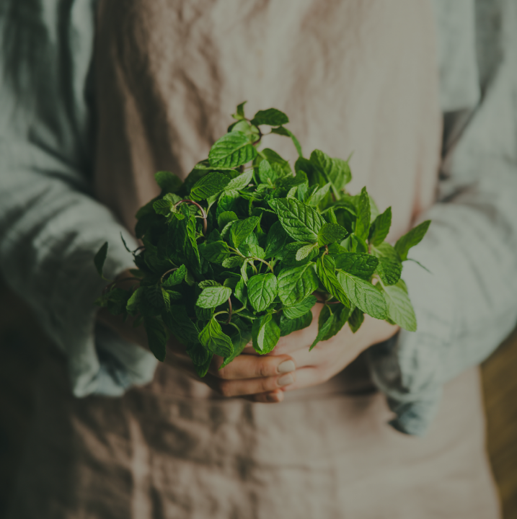
PROJECT DESCRIPTION
1
The project is the UNT dining system which comprises all the systems involved in dining services. This system is about every dining unit there is in the UNT and all its related resources and finances. It records orders of a particular dining outlet and stores order related data like payment and the items in the order. It also has a feature where users can choose to be Green-choice users where-in they pay and make use of reusable containers for their orders. Food order can be of certain filters like Vegan, Gluten-free and allergens-free. Each dining outlet can have a schedule. Customers can leave a review for their order. Each dining unit will have employees and a ledger system which will record data like assets and expenses. Dining outlets can have meal plans (example a $10 meal plan for students). Each employee will have an associated payroll data and the dining outlet will have records of its inventory and stock maintained by them. All this data is represented in the form of entities and relations.
About

Slide 4
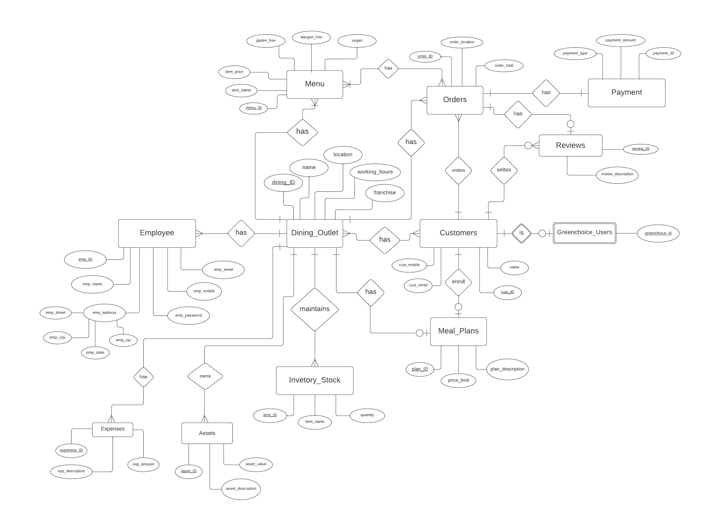
2
ER MODEL OF PROPOSED SYSTEM

Slide 5

TECH STACK
TOOLS AND TECHNOLOGY USED:
Tools:
MySQL,
Python-flask,
Visual studio code
Technologies:
HTML,
CSS,
MYSQL,
PYTHON,
BOOTSTRAP
3

Slide 6
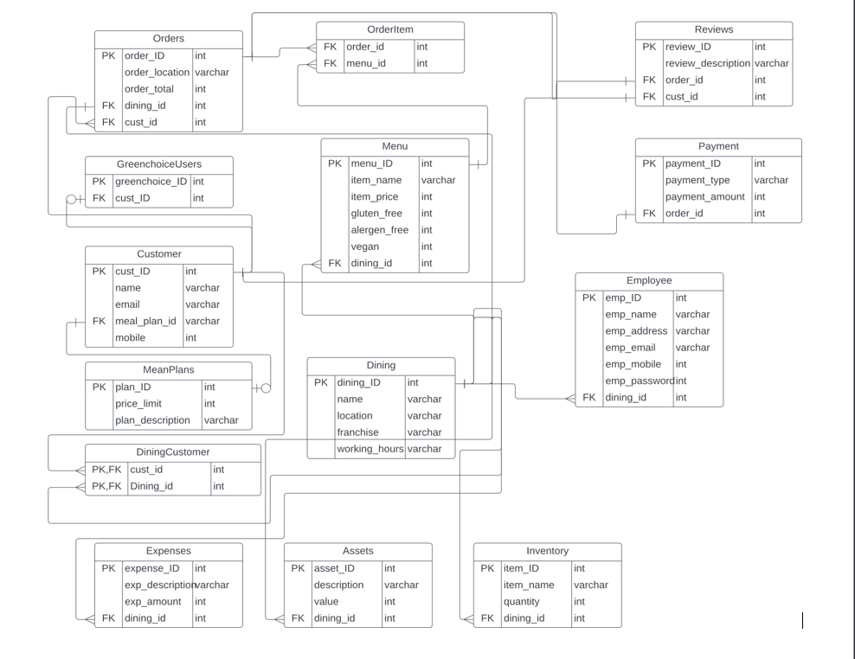
ER MAPPING
4

Slide 7
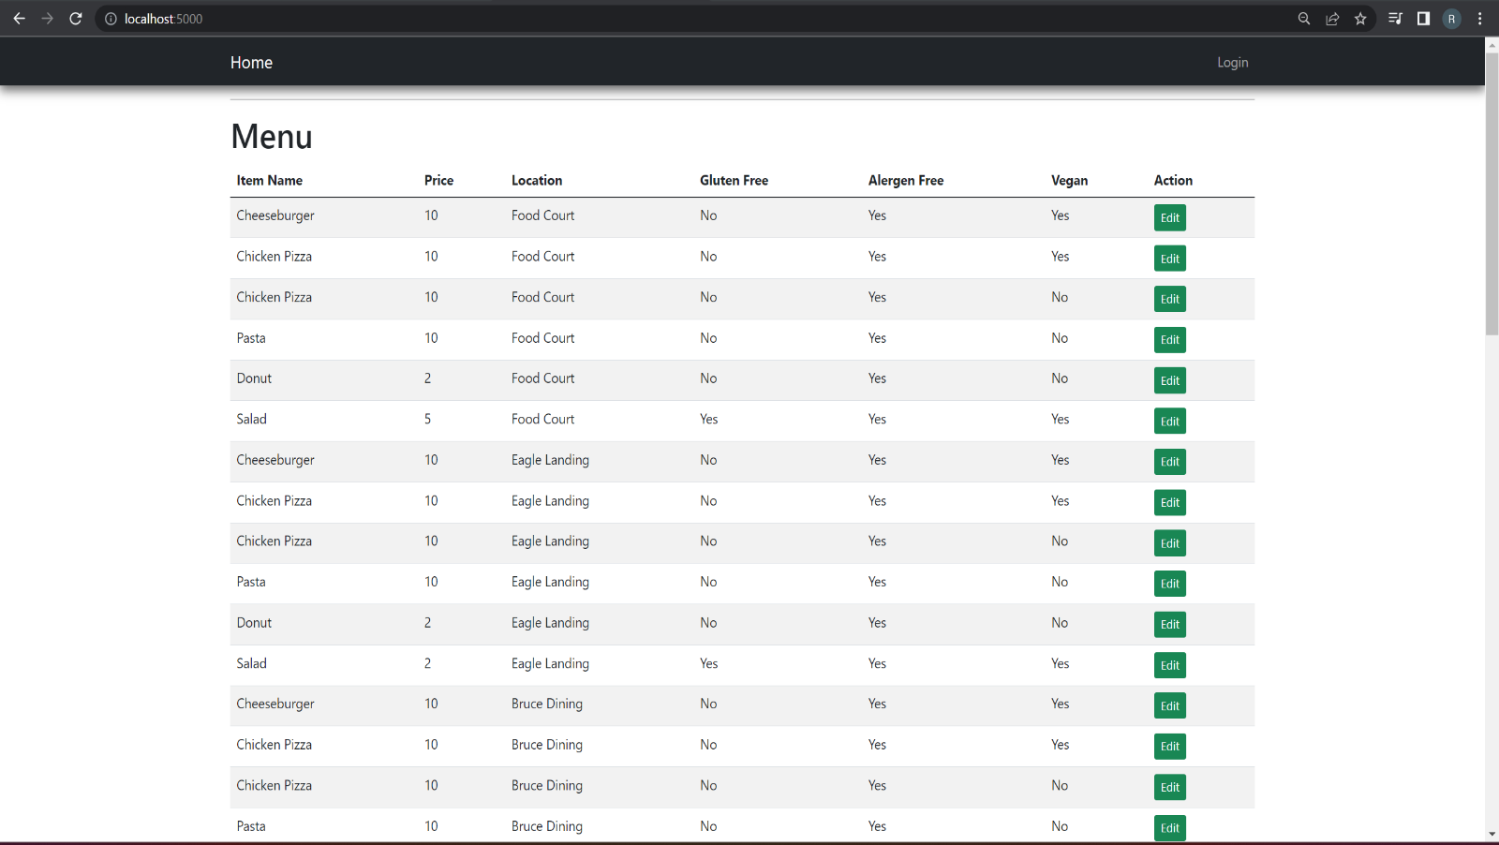
UNT DINING SYSTEM SCREENS
Home PAGE

Slide 8
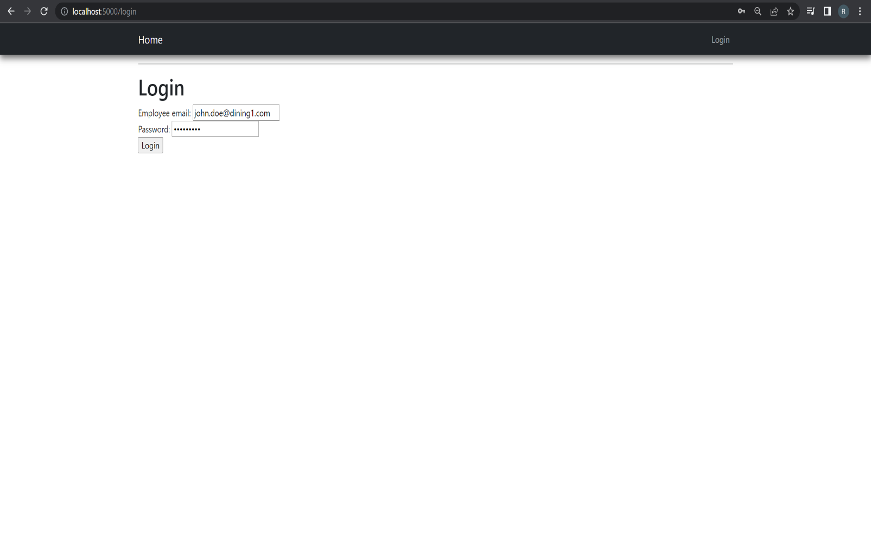
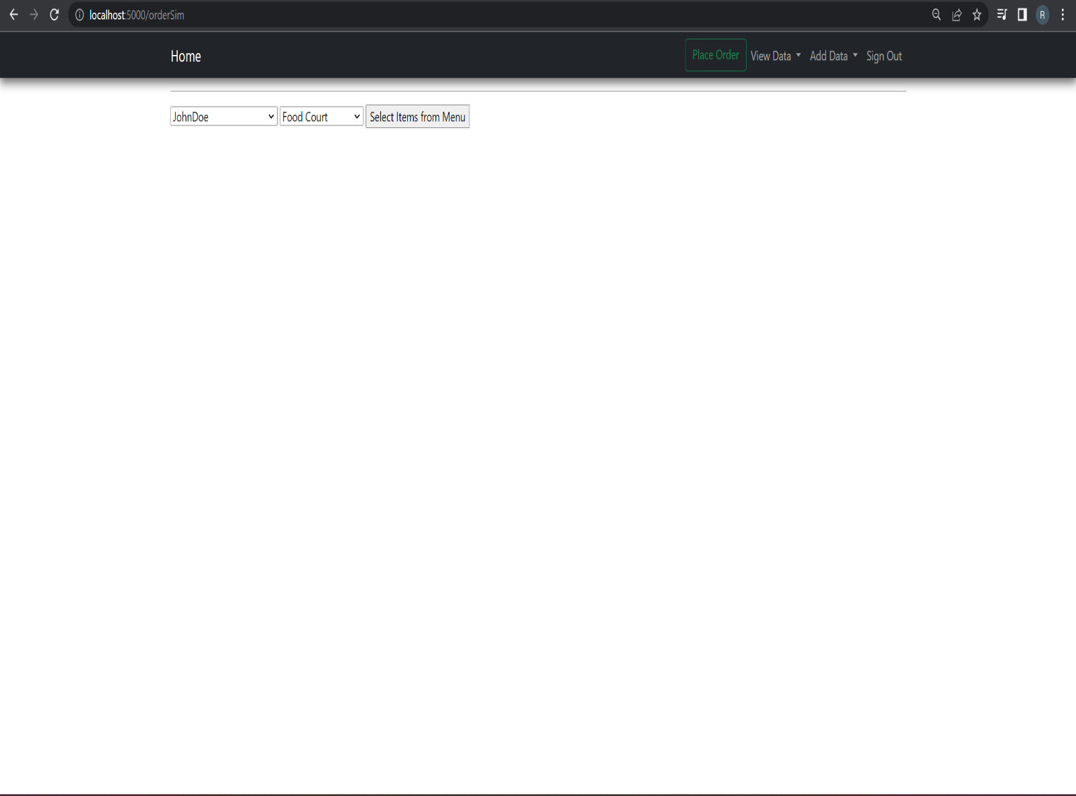
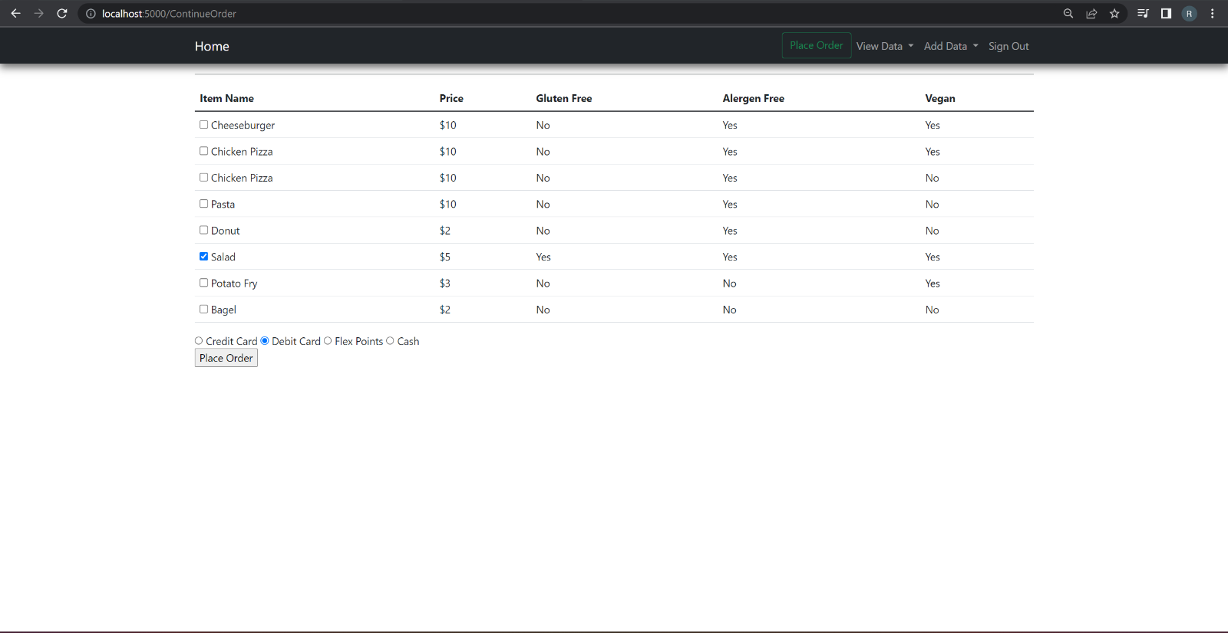
PLACE ORDER
Login

Slide 9
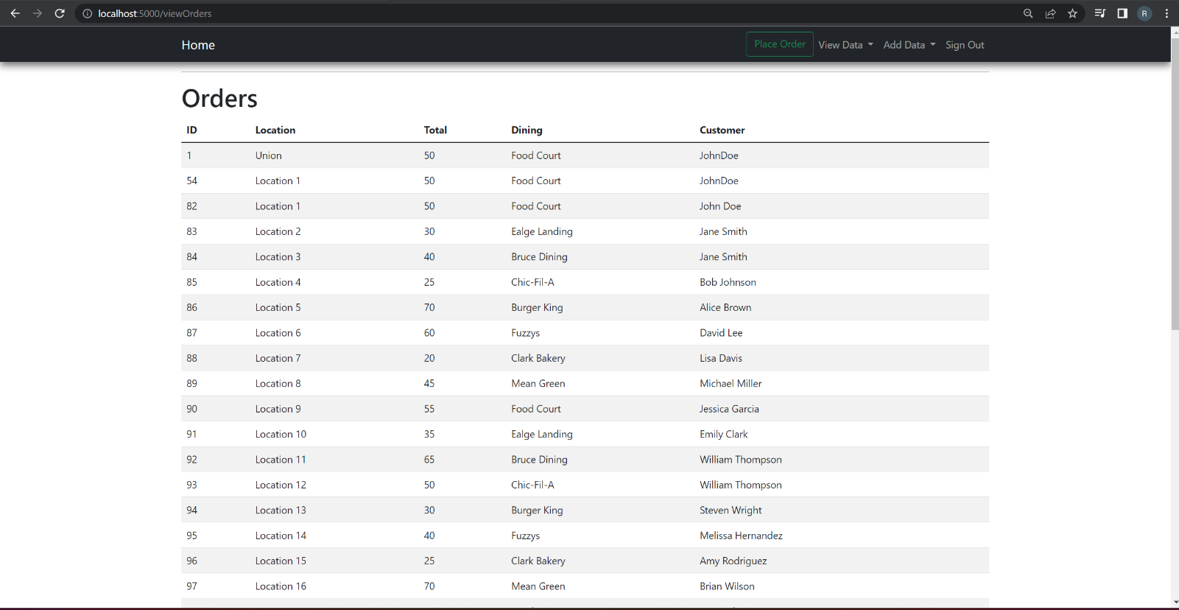
Orders Table after placing the order

Slide 10
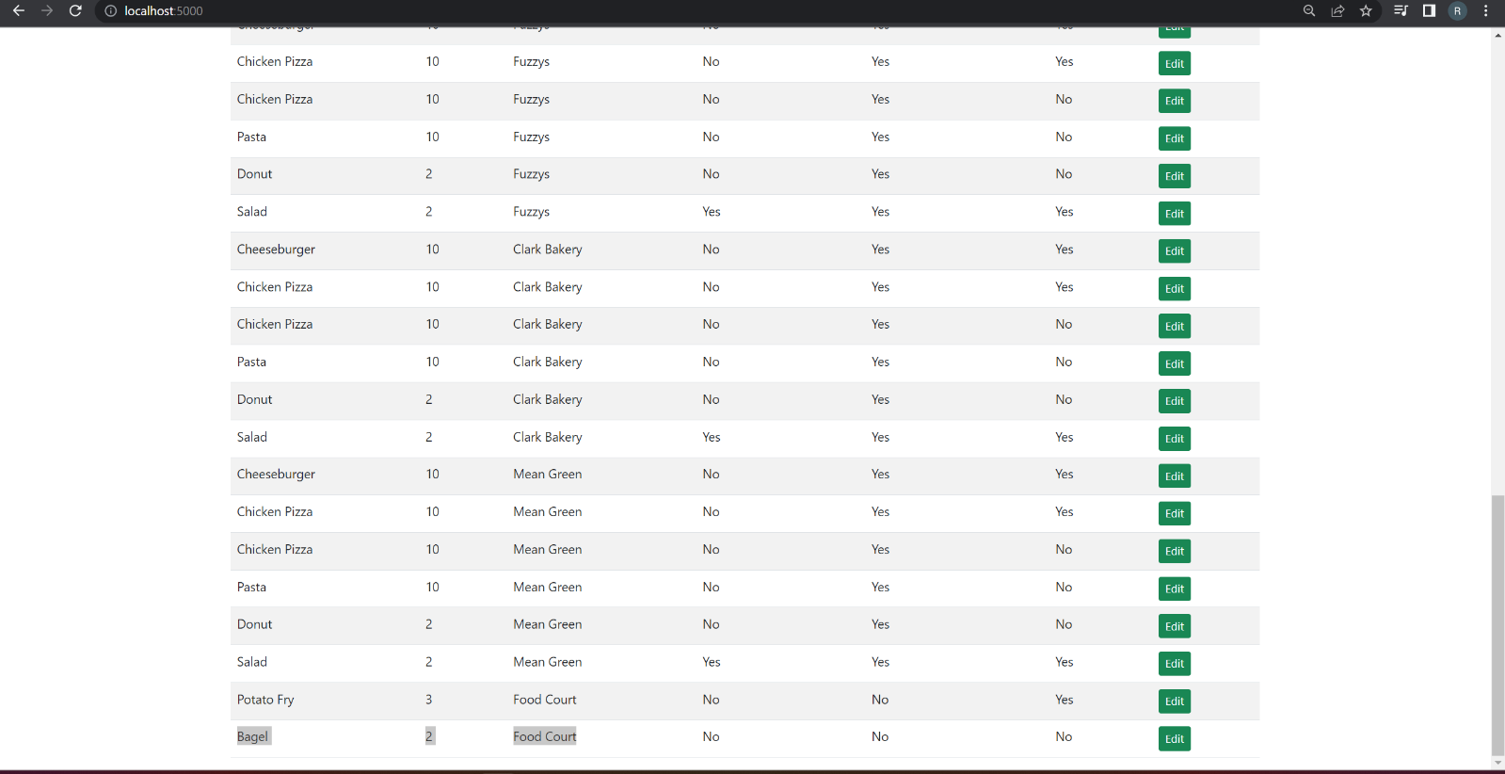
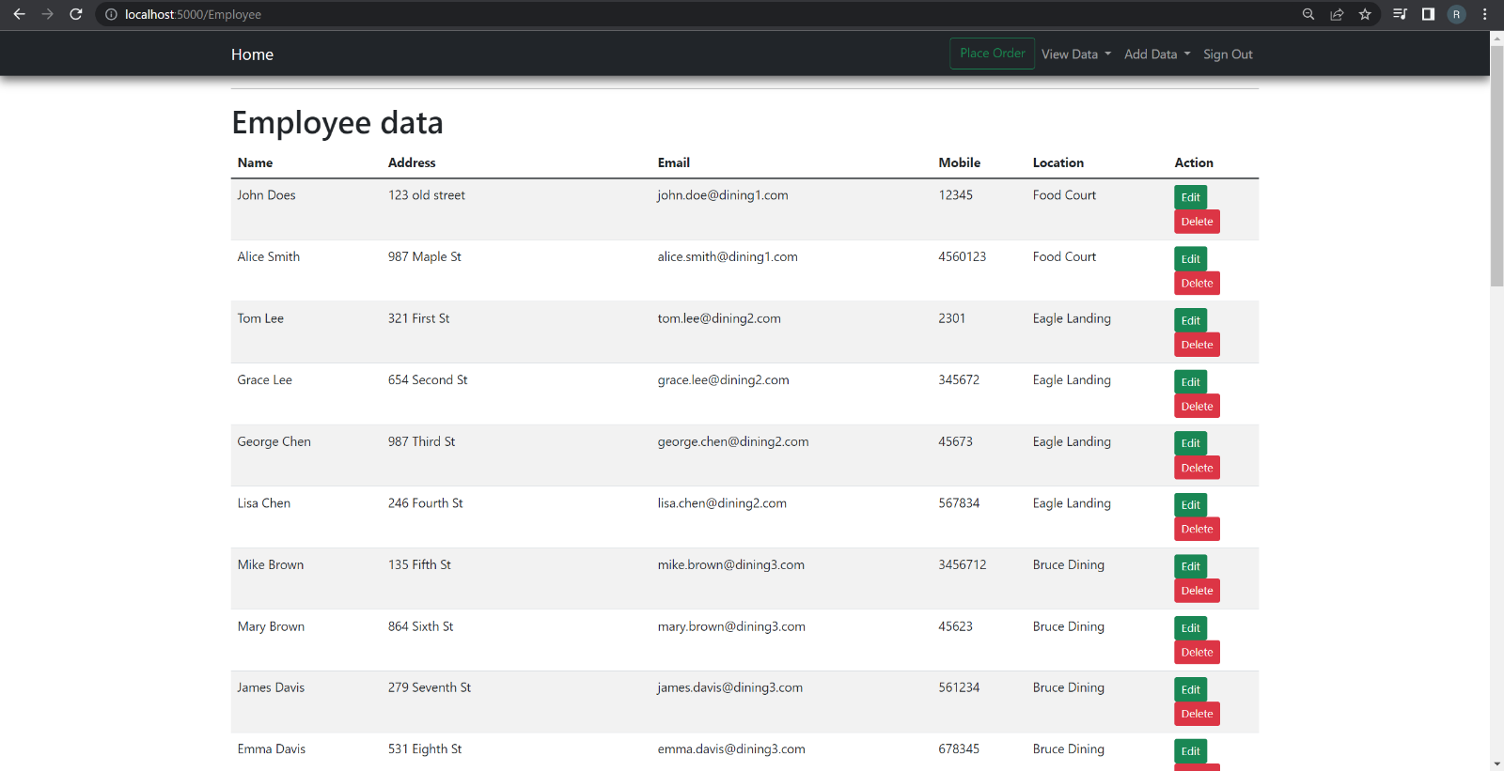
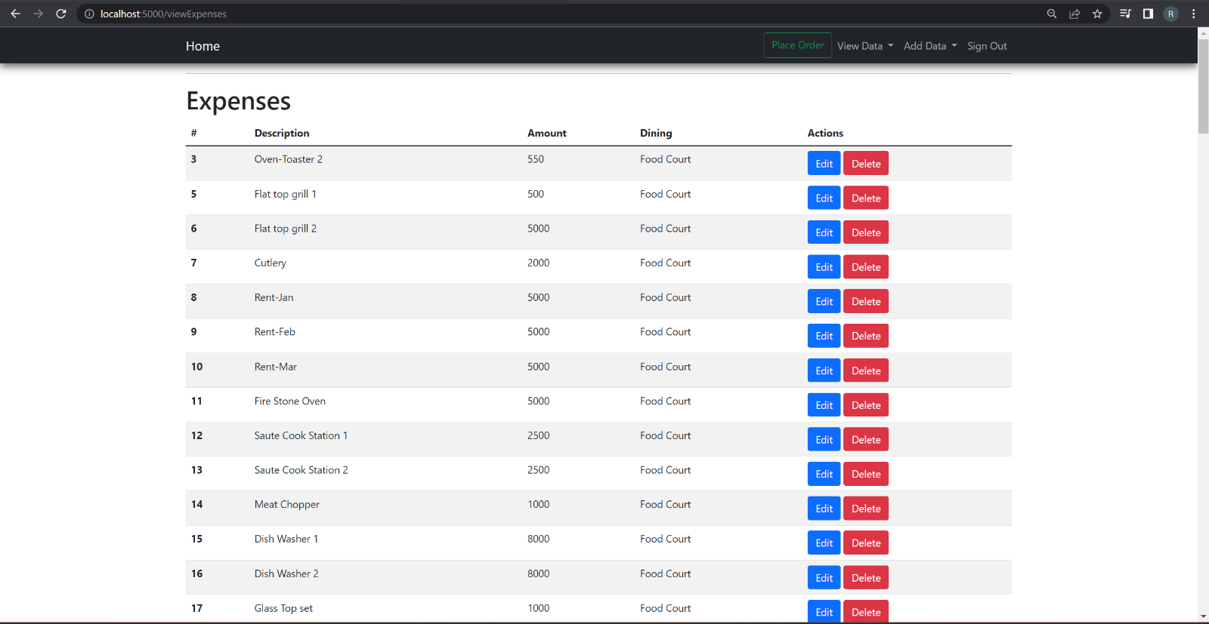
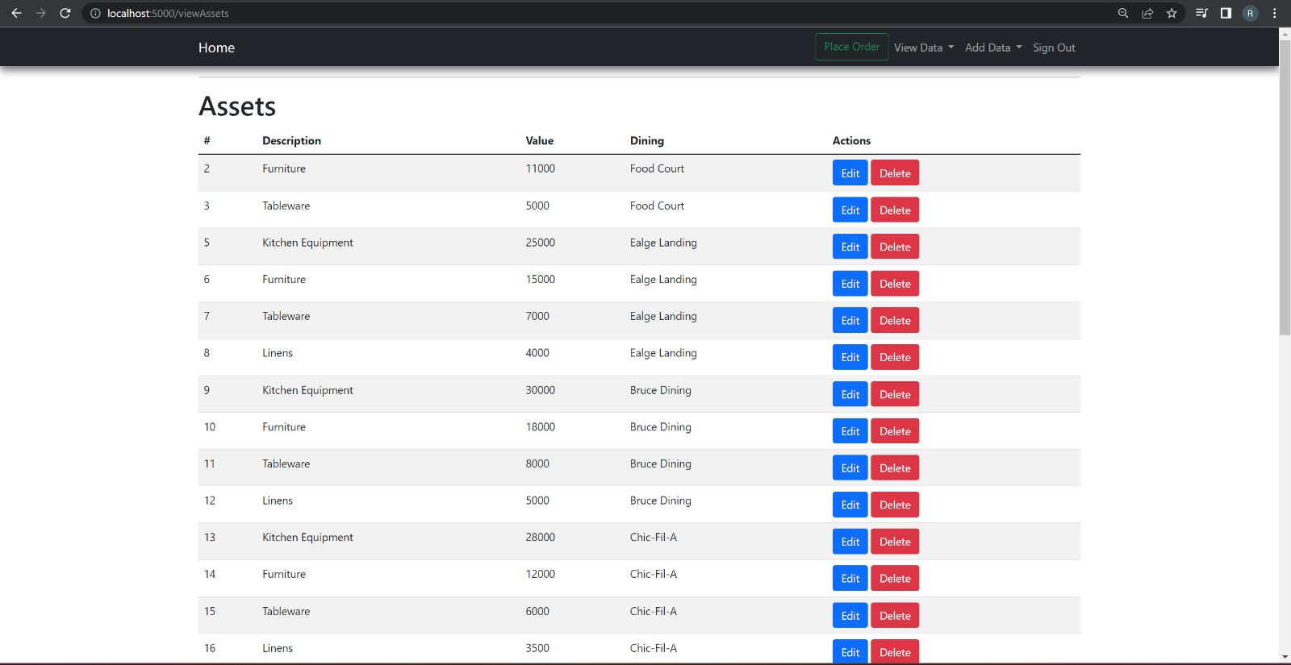
VIEW Menu
VIEW EMPLOYEE
VIEW EXPENSES
VIEW ASSETS

Slide 11
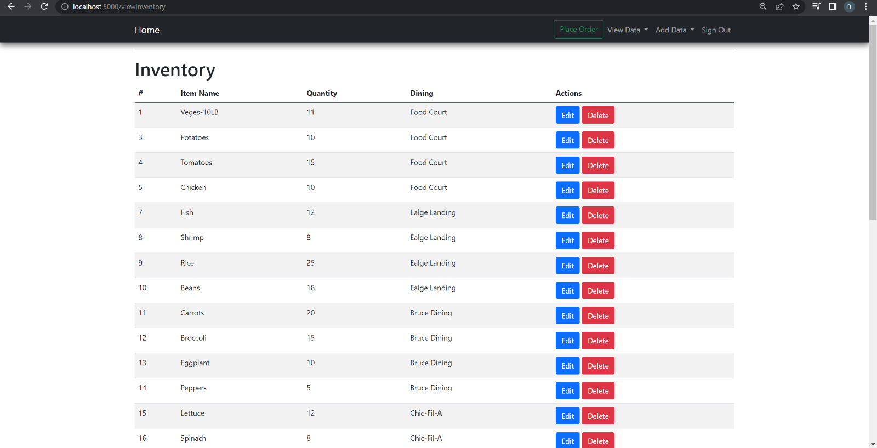
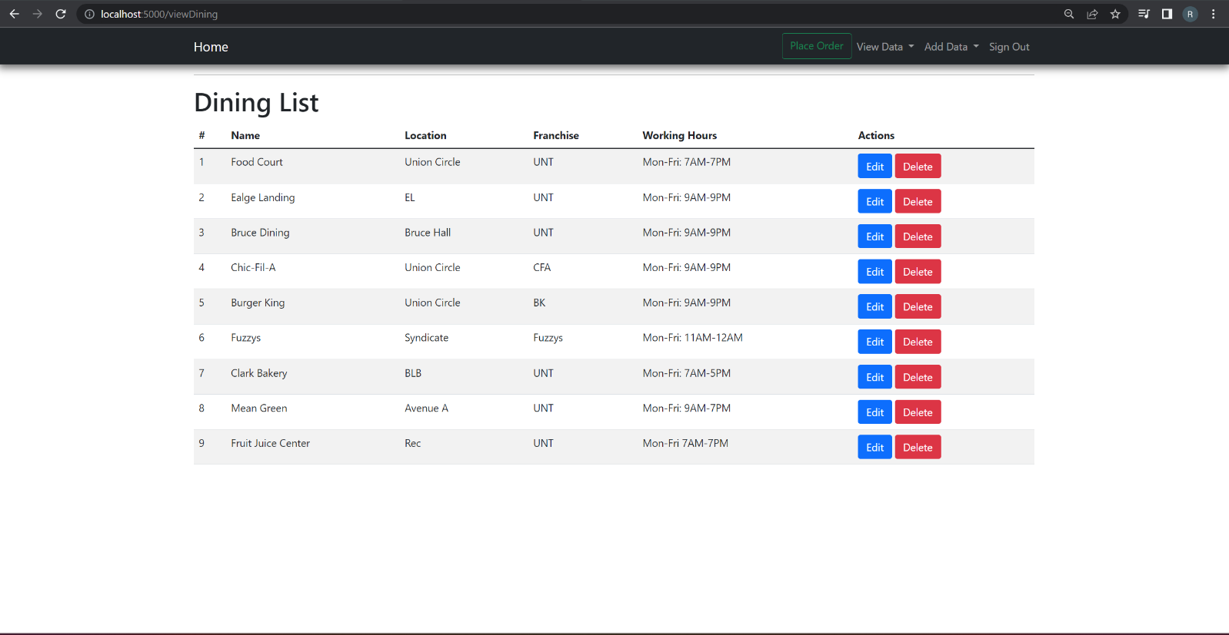
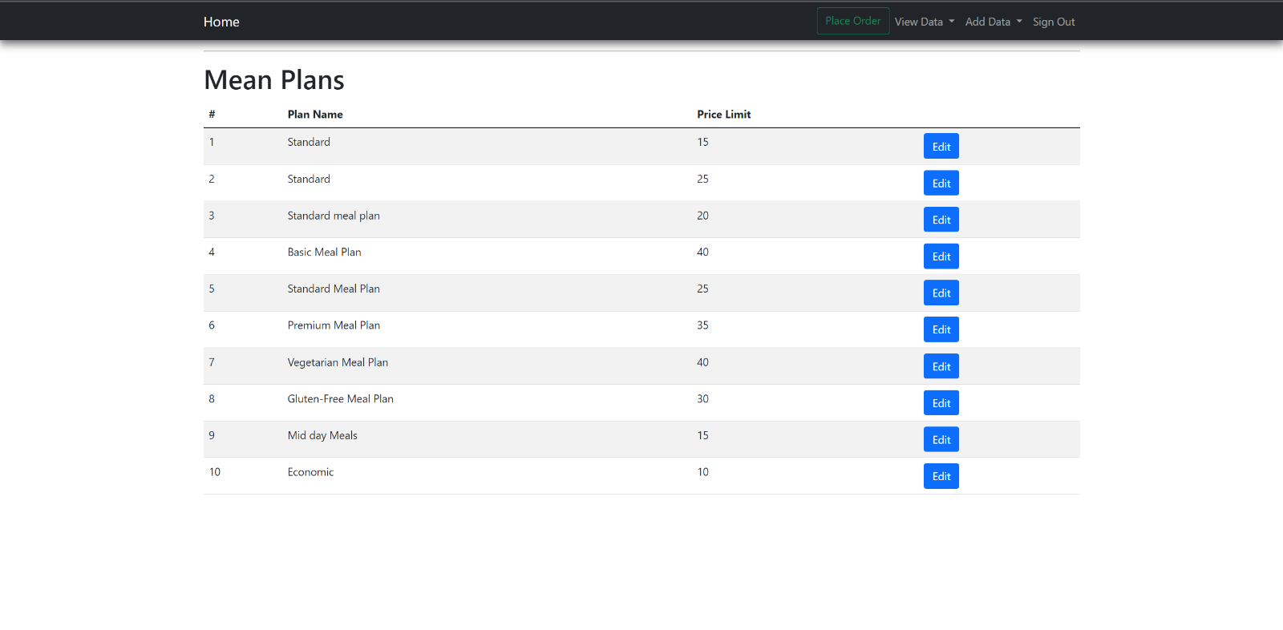
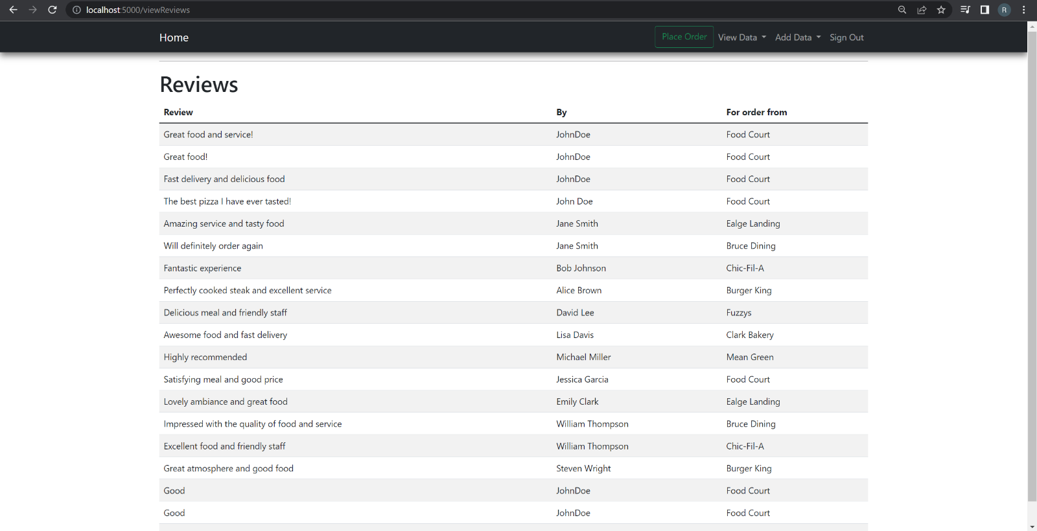
VIEW MEAL PLANS
VIEW INVENTORY
VIEW DINING
VIEW REVIEWS

Slide 12
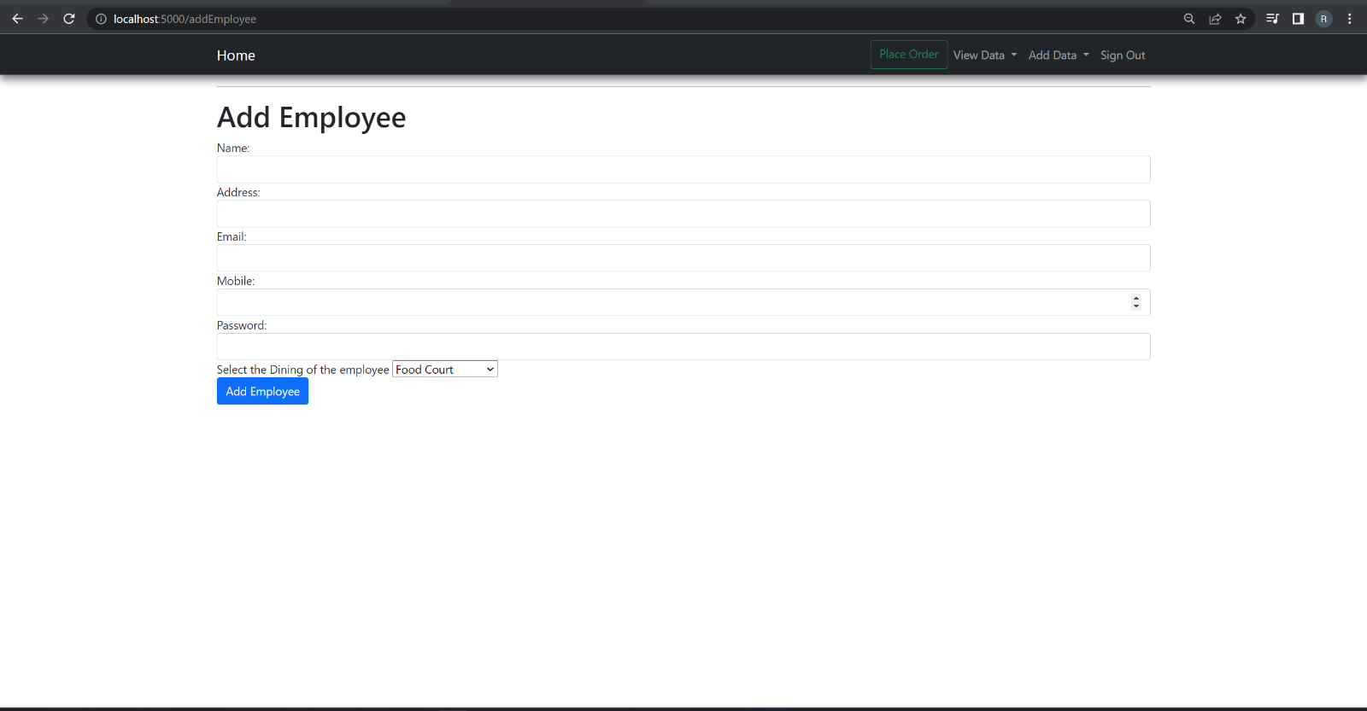
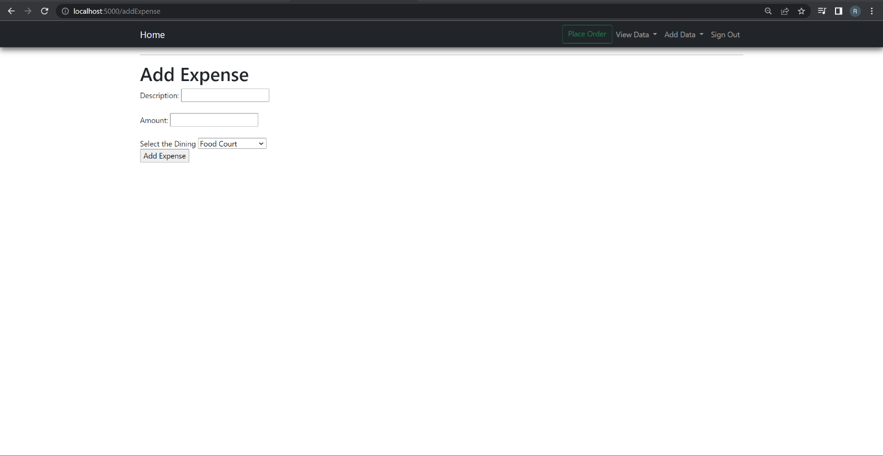
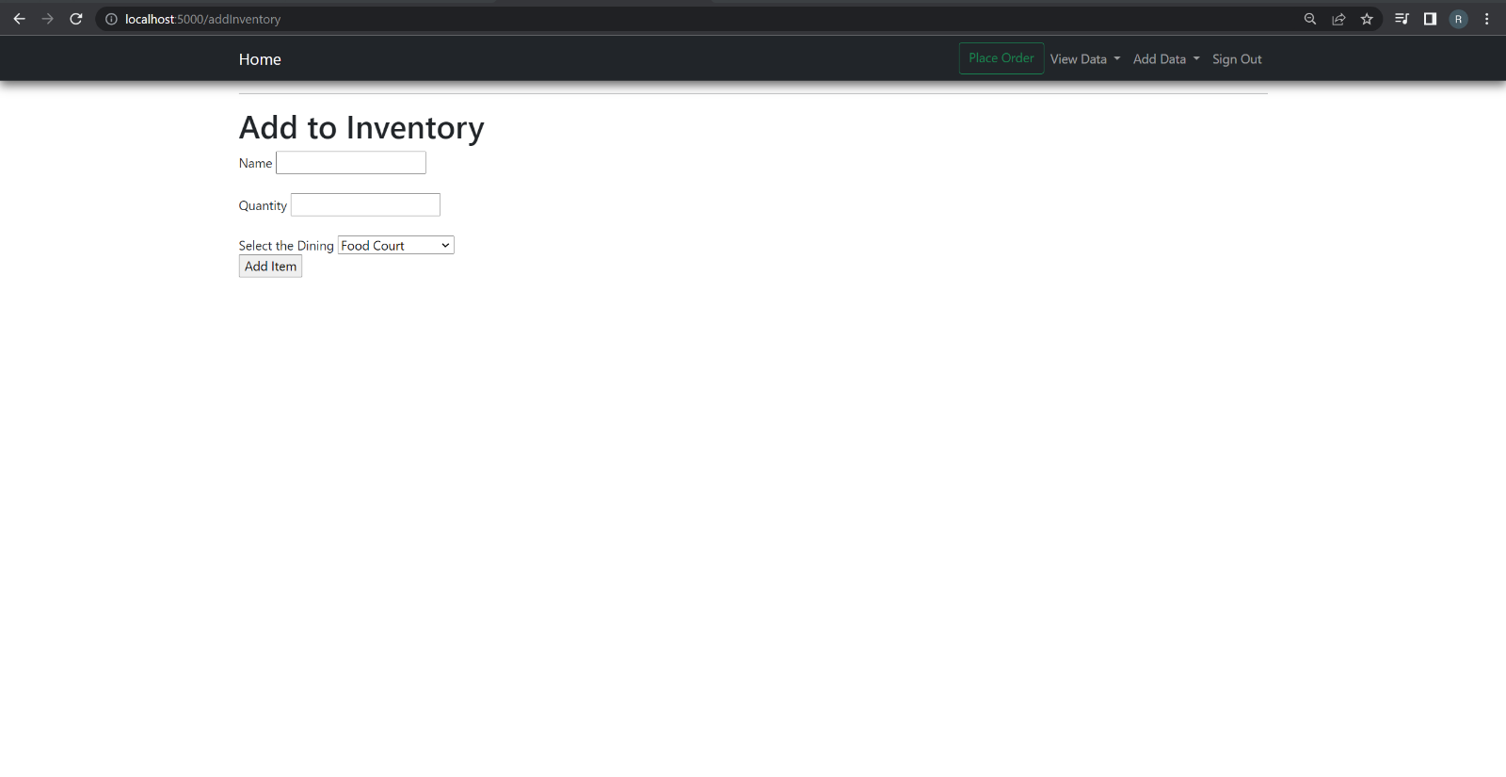
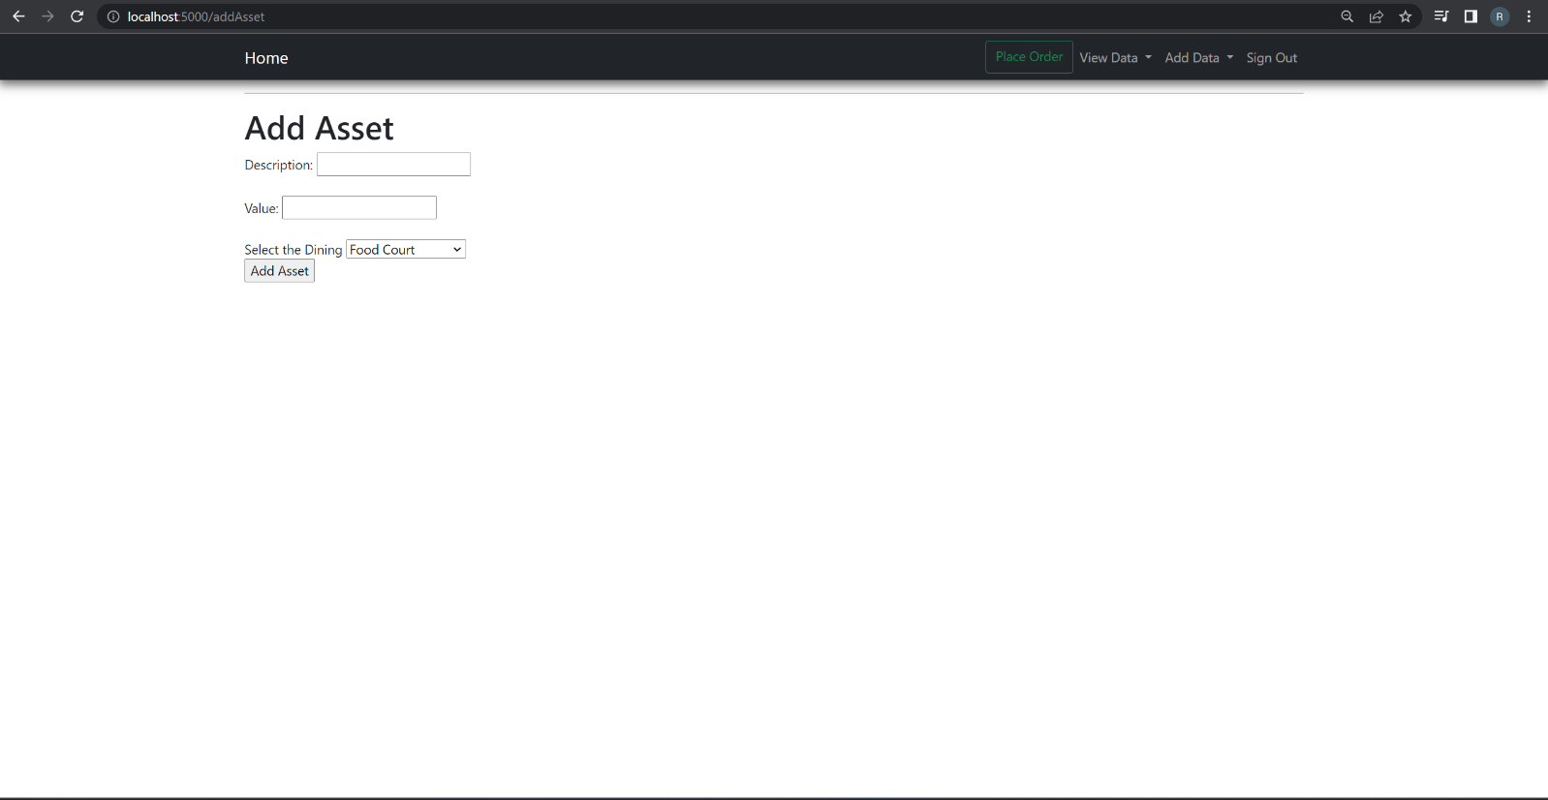
ADD INVENTORY
ADD EMPLOYEE
ADD EXPENSE
ADD ASSETS

Slide 13
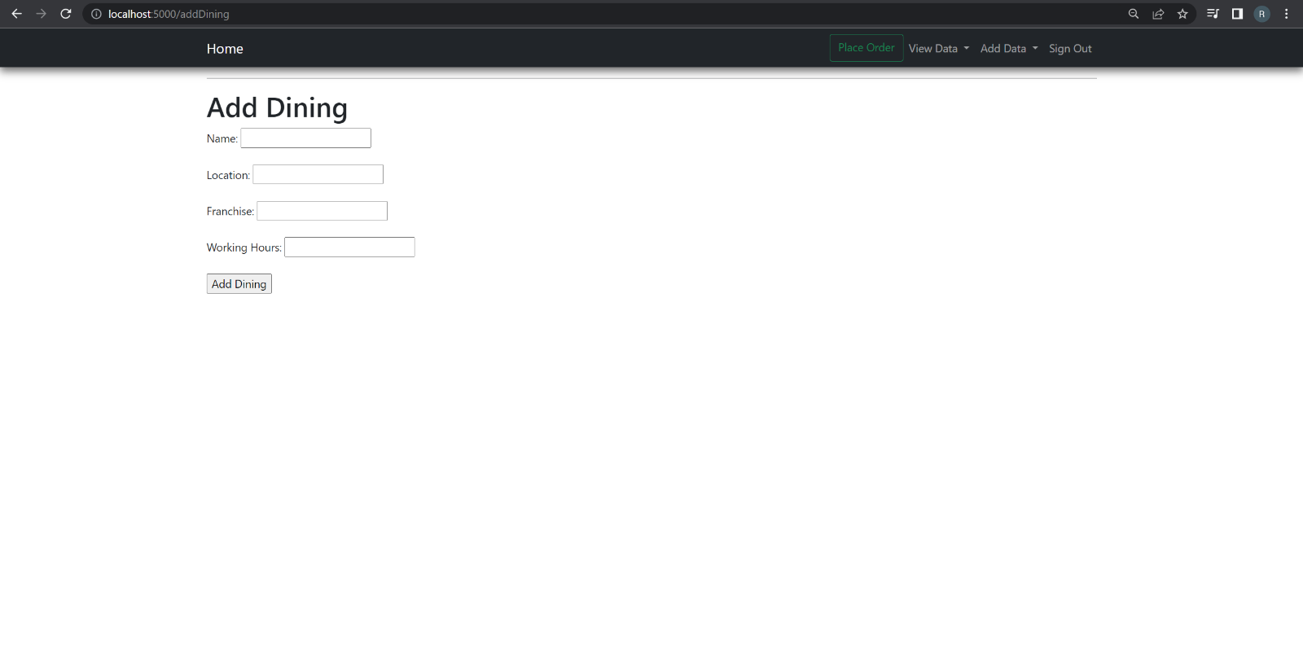
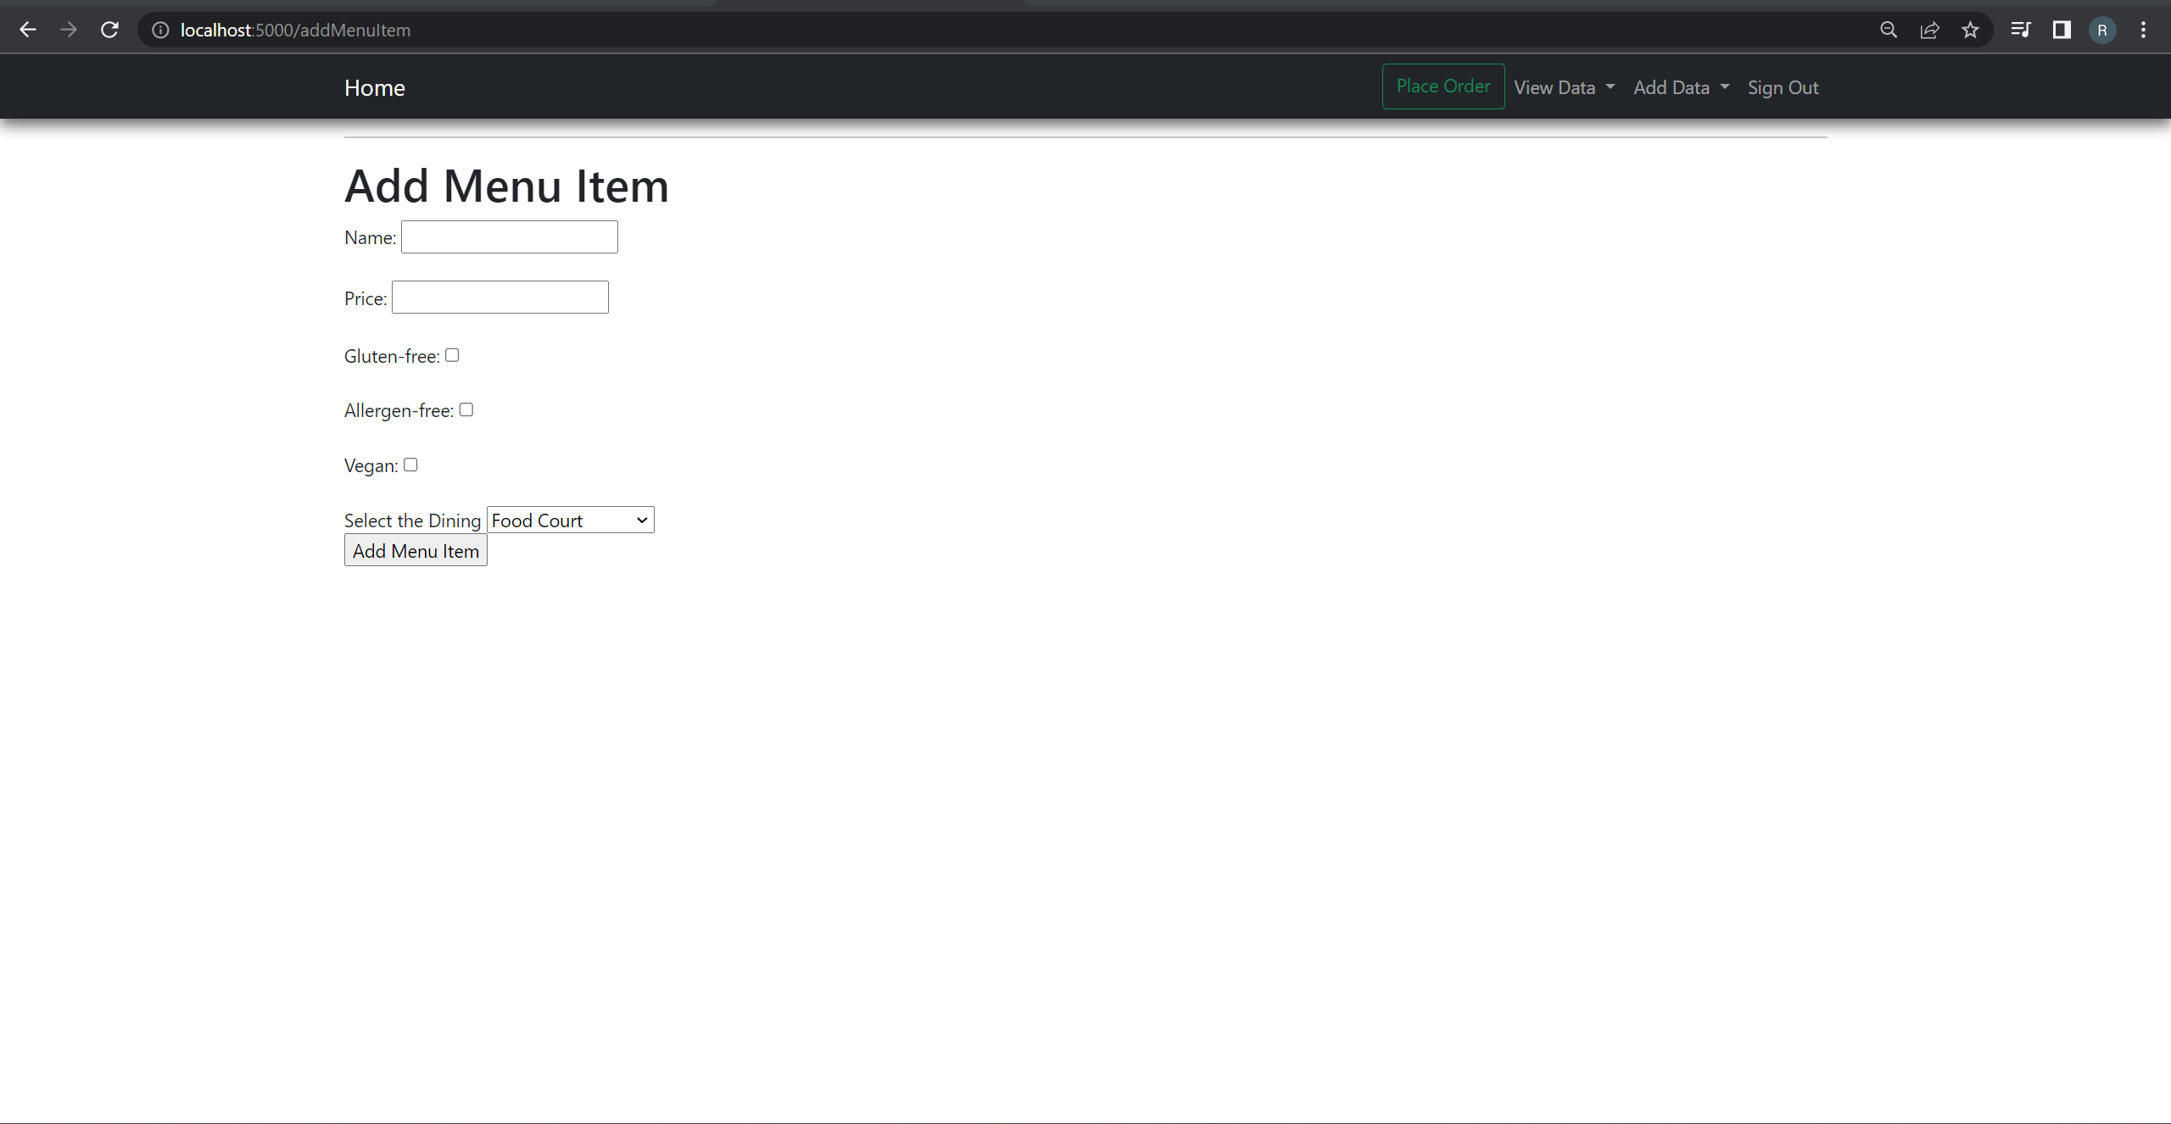
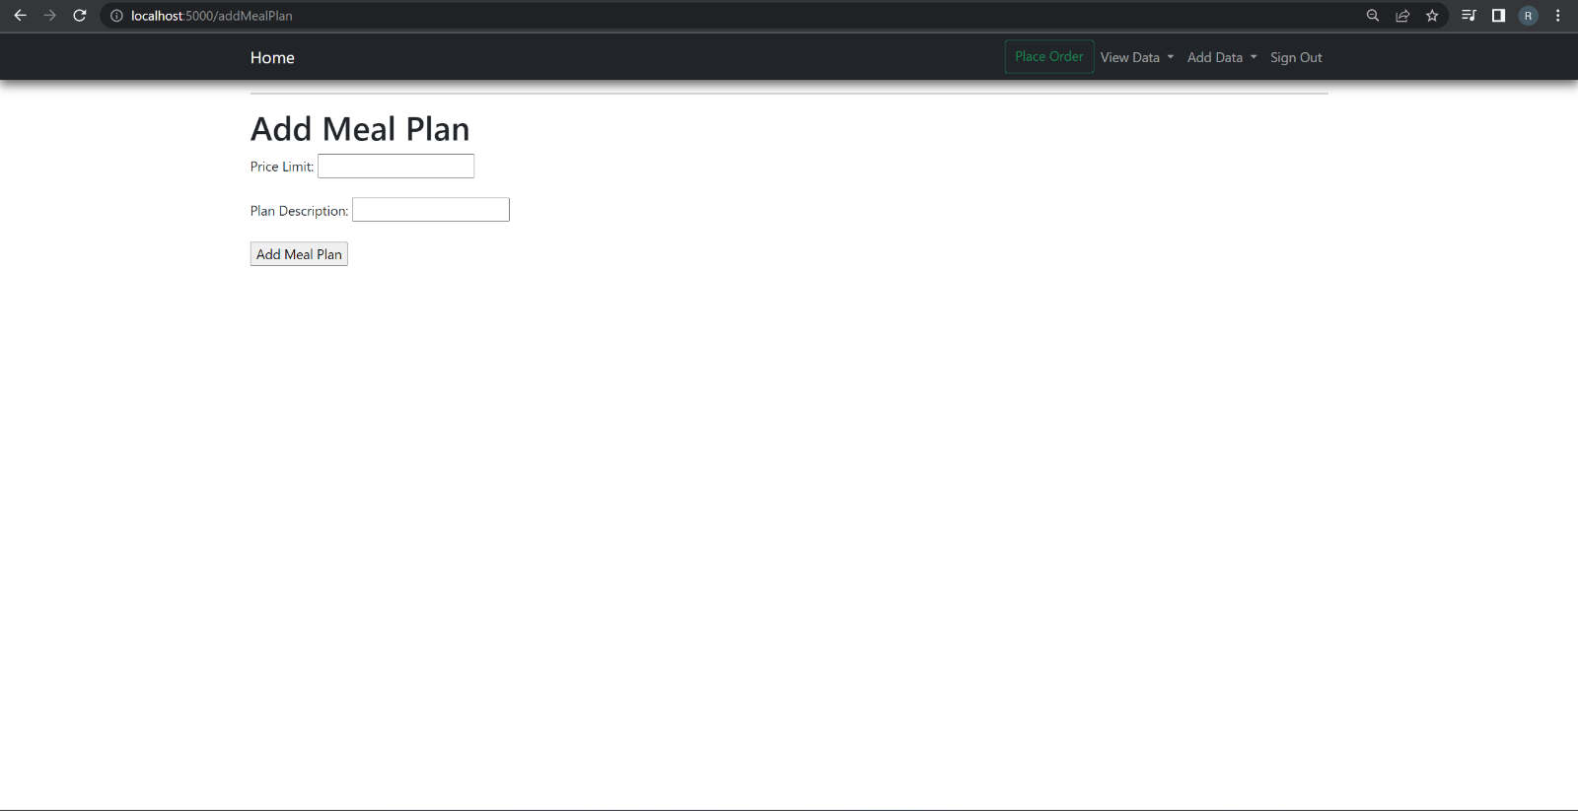
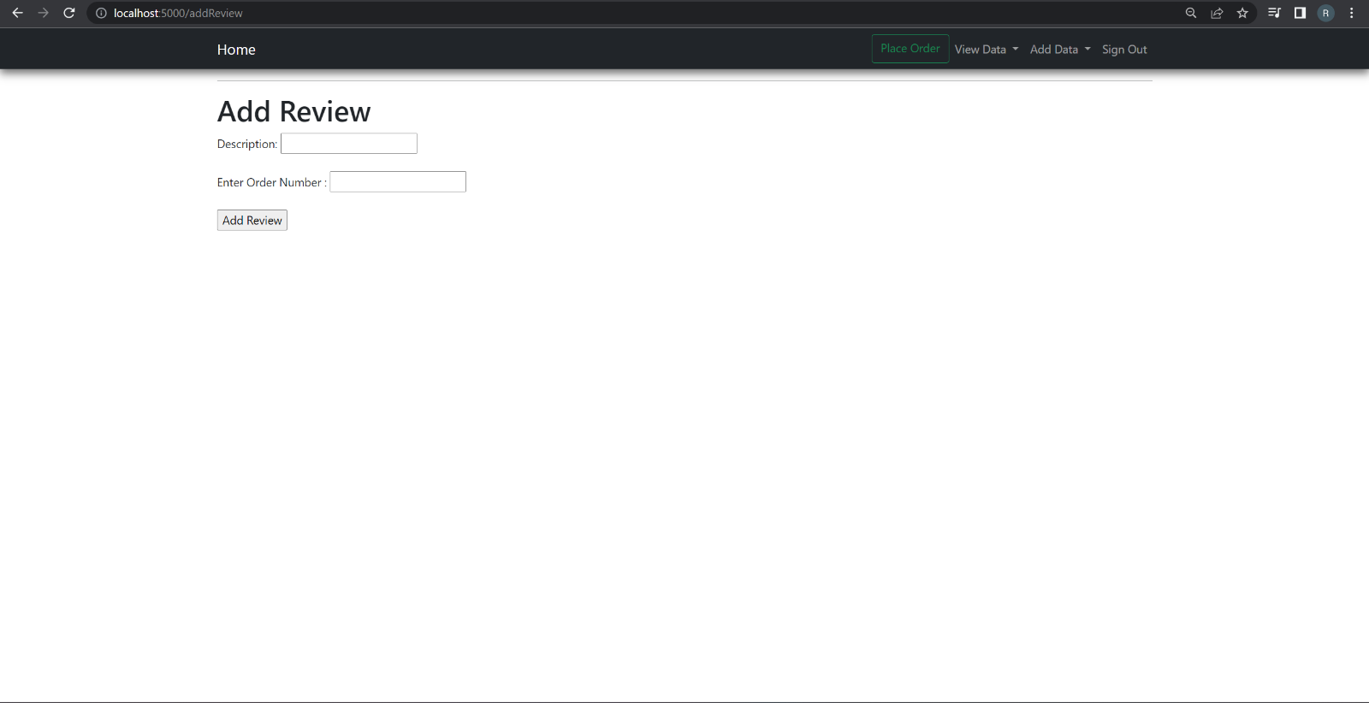
ADD MEAL PLAN
ADD DINING
ADD menu
ADD REVIEWS

Slide 14

THANK YOU

